Slide 1
Big Data Analytics using Apache Spark

Slide 2
Key-Value Pair RDDs
Spark Paired RDDs are nothing but RDDs containing a key-value pair. Basically, key-value pair (KVP) consists of a two linked data item in it. Here, the key is the identifier, whereas value is the data corresponding to the key value.
Moreover, Spark operations work on RDDs containing any type of objects. However key-value pair RDDs attains few special operations in it. Such as, distributed “shuffle” operations, grouping or aggregating the elements by a key.
In addition, on Spark Paired RDDs containing Tuple2 objects in Scala, these operations are automatically available. Basically, operations for the key-value pair are available in the Pair RDD functions class. However, that wraps around a Spark RDD of tuples.

Slide 3
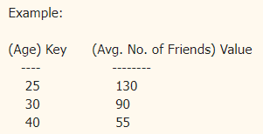
Key-Value Pair RDDs
A key/value pair is a set of two data items:
1) Key: which is a unique identifier for a value
2) Value: which is the data that is identified by the Key
Key/Value pair is the common data type in Spark that is required for many operations. And it is most commonly used for aggregation. And in Spark, the key/Value pair is represented as a tuple with two elements. Example: (25, 130) , (30, 90) and (40, 55). The first element is called Key and the second element is called Value.

Slide 4
RDD Persistence
Spark RDD persistence is an optimization technique in which saves the result of RDD evaluation. Using this we save the intermediate result so that we can use it further if required. It reduces the computation overhead.
We can make persisted RDD through cache() and persist() methods. When we use the cache() method we can store all the RDD in-memory. We can persist the RDD in memory and use it efficiently across parallel operations.
The difference between cache() and persist() is that using cache() the default storage level is MEMORY_ONLY while using persist() we can use various storage levels (described below). It is a key tool for an interactive algorithm. Because, when we persist RDD each node stores any partition of it that it computes in memory and makes it reusable for future use. This process speeds up the further computation ten times.
When the RDD is computed for the first time, it is kept in memory on the node. The cache memory of the Spark is fault tolerant so whenever any partition of RDD is lost, it can be recovered by transformation Operation that originally created it.

Slide 5
RDD Persistence
There are some advantages of RDD caching and persistence mechanism in spark. It makes the whole system
Time efficient
Cost efficient
Lesser the execution time.

Slide 6
SPARK SQL
Spark SQL is a component on top of Spark Core that introduces a new data abstraction called SchemaRDD, which provides support for structured and semi-structured data.
Spark introduces a programming module for structured data processing called Spark SQL. It provides a programming abstraction called DataFrame and can act as distributed SQL query engine.

Slide 7
SPARK SQL
The following are the features of Spark SQL −
Integrated − Seamlessly mix SQL queries with Spark programs. Spark SQL lets you query structured data as a distributed dataset (RDD) in Spark, with integrated APIs in Python, Scala and Java. This tight integration makes it easy to run SQL queries alongside complex analytic algorithms.
Unified Data Access − Load and query data from a variety of sources. Schema-RDDs provide a single interface for efficiently working with structured data, including Apache Hive tables, parquet files and JSON files.
Hive Compatibility − Run unmodified Hive queries on existing warehouses. Spark SQL reuses the Hive frontend and MetaStore, giving you full compatibility with existing Hive data, queries, and UDFs. Simply install it alongside Hive.

Slide 8
SPARK SQL
Standard Connectivity − Connect through JDBC or ODBC. Spark SQL includes a server mode with industry standard JDBC and ODBC connectivity.
Scalability − Use the same engine for both interactive and long queries. Spark SQL takes advantage of the RDD model to support mid-query fault tolerance, letting it scale to large jobs too. Do not worry about using a different engine for historical data.

Slide 9
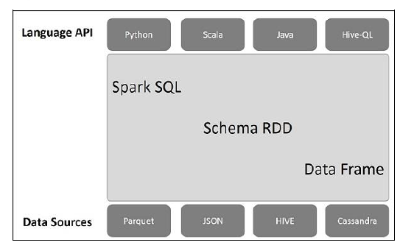
Architecture of SPARK SQL

Slide 10
SPARK SQL
Language API − Spark is compatible with different languages and Spark SQL. It is also, supported by these languages- API (python, scala, java, HiveQL).
Schema RDD − Spark Core is designed with special data structure called RDD. Generally, Spark SQL works on schemas, tables, and records. Therefore, we can use the Schema RDD as temporary table. We can call this Schema RDD as Data Frame.
Data Sources − Usually the Data source for spark-core is a text file, Avro file, etc. However, the Data Sources for Spark SQL is different. Those are Parquet file, JSON document, HIVE tables, and Cassandra database.

Slide 11
Data frames and datasets
A DataFrame is a distributed collection of data, which is organized into named columns. Conceptually, it is equivalent to relational tables with good optimization techniques.
A DataFrame can be constructed from an array of different sources such as Hive tables, Structured Data files, external databases, or existing RDDs. This API was designed for modern Big Data and data science applications taking inspiration from DataFrame in R Programming and Pandas in Python.

Slide 12
Data frames and datasets
Here is a set of few characteristic features of DataFrame −
Ability to process the data in the size of Kilobytes to Petabytes on a single node cluster to large cluster.
Supports different data formats (Avro, csv, elastic search, and Cassandra) and storage systems (HDFS, HIVE tables, mysql, etc).
State of art optimization and code generation through the Spark SQL Catalyst optimizer (tree transformation framework).
Can be easily integrated with all Big Data tools and frameworks via Spark-Core.
Provides API for Python, Java, Scala, and R Programming.

Slide 13
Datasets
A Dataset is a strongly-typed, immutable collection of objects that are mapped to a relational schema. At the core of the Dataset API is a new concept called an encoder, which is responsible for converting between JVM objects and tabular representation.
The tabular representation is stored using Spark’s internal Tungsten binary format, allowing for operations on serialized data and improved memory utilization. Spark 1.6 comes with support for automatically generating encoders for a wide variety of types, including primitive types (e.g. String, Integer, Long), Scala case classes, and Java Beans.
Users of RDDs will find the Dataset API quite familiar, as it provides many of the same functional transformations (e.g. map, flatMap, filter). Consider the following code, which reads lines of a text file and splits them into words:

Slide 14
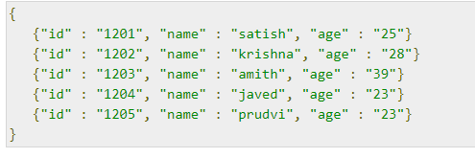
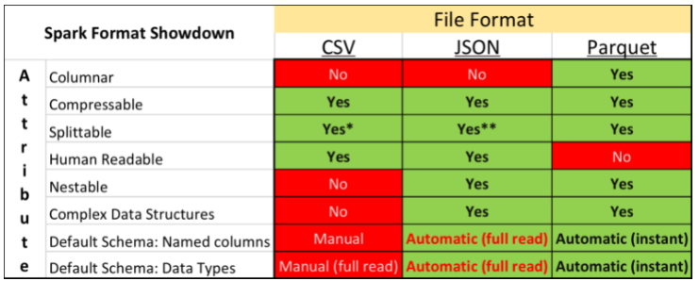
JSON and Parquet file formats
Apache Spark supports many different data sources, such as the ubiquitous Comma Separated Value (CSV) format and web API friendly JavaScript Object Notation (JSON) format. A common format used primarily for big data analytical purposes is Apache Parquet. Parquet is a fast columnar data format

Slide 15
JSON and Parquet file formats
Apache Parquet is a columnar storage format that can efficiently store nested data. Columnar formats are attractive since they enable greater efficiency, in terms of both file size and query performance. File sizes are usually smaller than row-oriented equivalents since in a columnar format the values from one column are stored next to each other, which usually allows a very efficient encoding.
A column storing a timestamp, for example, can be encoded by storing the first value and the differences between subsequent values (which tend to be small due to temporal locality: records from around the same time are stored next to each other). Query performance is improved too since a query engine can skip over columns that are not needed to answer a query.
A key strength of Parquet is its ability to store data that has a deeply nested structure in true columnar fashion. This is important since schemas with several levels of nesting are common in real-world systems.

Slide 16
JSON and Parquet file formats
AParquet uses a novel technique for storing nested structures in a flat columnar format with little overhead, which was introduced by Google engineers in the Dremel paper.1 The result is that even nested fields can be read independently of other fields, resulting in significant performance improvements.
Another feature of Parquet is the large number of tools that support it as a format. The engineers at Twitter and Cloudera who created Parquet wanted it to be easy to try new tools to process existing data, so to facilitate this they divided the project into a specification (parquet-format), which defines the file format in a language-neutral way, and implementations of the specification for different languages (Java and C++) that made.

Slide 17
JSON and Parquet file formats
Apache Parquet is column-oriented and designed to bring efficient columnar storage of data compared to row-based like CSV
Apache Parquet is built from the ground up with complex nested data structures in mind
Apache Parquet is built to support very efficient compression and encoding schemes (seeGoogle Snappy)
Apache Parquet allows to lower storage costs for data files and maximizes the effectiveness of querying data with serverless technologies like Amazon Athena, Redshift Spectrum, BigQuery, and Azure Data Lakes.

Slide 18
Thank You

